Slide 1
MySQL Workbench Instructions

Slide 2
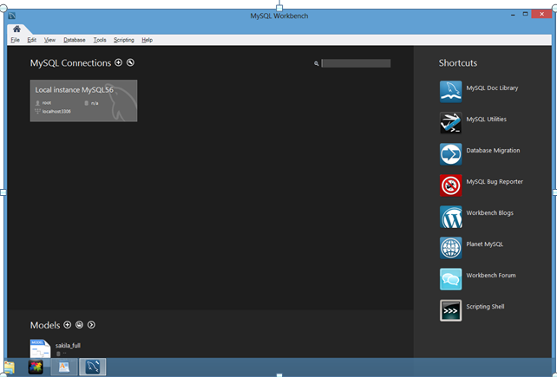
_{MySQL Workbench First Screen}
Double-Click on the Local Instance MySQL 5.6 Connection. Enter your password if prompted.

Slide 3
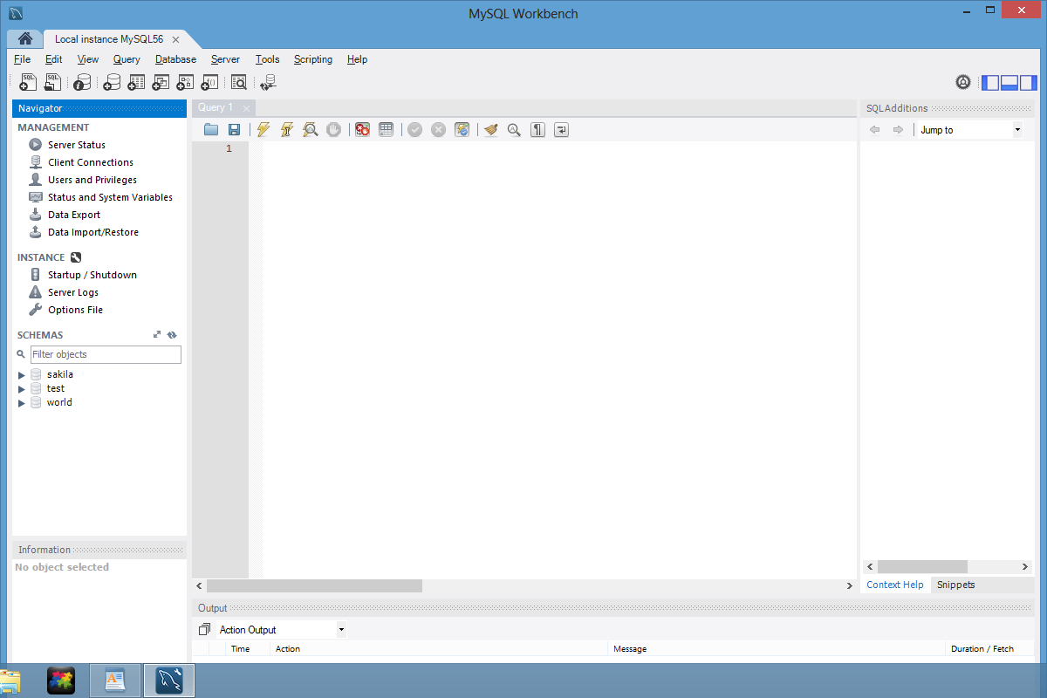
_{MySQL Workbench Screen}

Slide 4
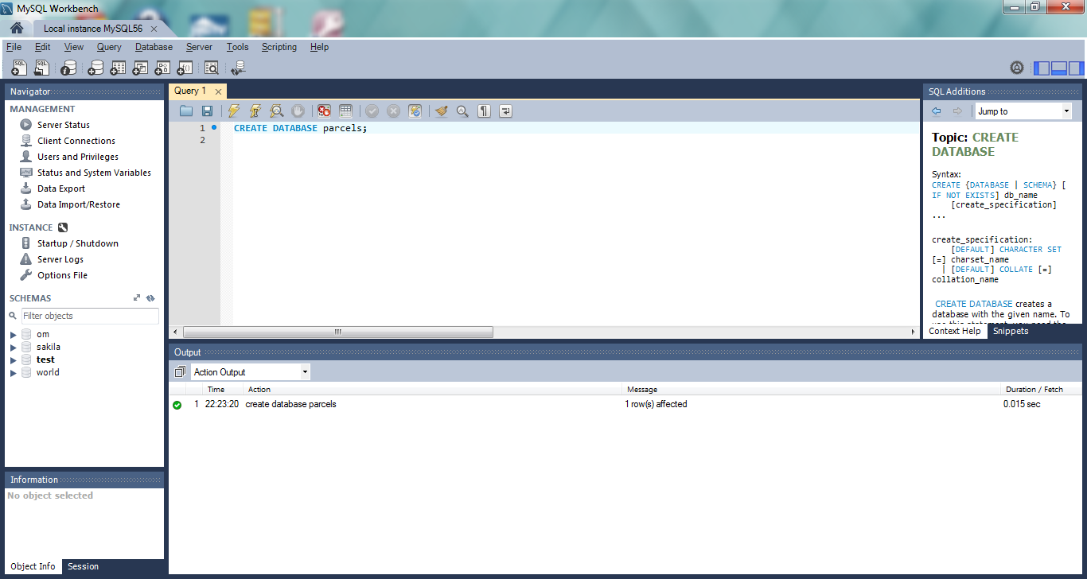
_{Enter SQL Commands}
Enter SQL Commands here. Click here to execute the command which is highlighted. Output messages are displayed here. Start/stop MySQL here.

Slide 5
Workbench Information
Stop and start the database server
In the Task and Object Browser section of the Admin tab, select the startup/shutdown category.
After you install the MySQL Community Server the database
server usually starts automatically.
Database Objects
Each database provides access to the database objects that are
available which include tables, views and routines.
To navigate through the database objects for a database, click on
the arrow to the left of the nodes in the Object Browser window to expand/collapse the node.
To work with a node or an object, right-click on the node or object and select the command from the resulting menu.

Slide 6
Display Table Data
To view the data for a table, right-click on the table in the Object Browser window and select the Edit Table Data command to display it in a Result tab.
To edit the data for table, view the data. Then you can use the buttons at the top of the Result tab to insert, update and delete rows.
To apply the changes to the table, click the Apply button at the top of the tab.

Slide 7
Display Column Definitions
To view the column definitions for table, right-click on the table name in the Object Browser window, select the Alter table command, select the columns tab at the bottom of the window that’s displayed to view the column definitions for the table.
To edit the column definitions for table, view the column definitions. Then you can use the resulting window to add new columns and modify and delete existing columns.

Slide 8
Execute SQL statements in Workbench
To open a new code editor tab press the Ctrl + T keys or click the Create New SQL Tab button in the SQL Editor toolbar.
To select the current database, double-click it in the Object
Browser window the selected databases displayed in bold.
To enter an SQL statement, type it into the code editor tab.
As you enter the text for a statement, the code editor tab
applies color to various elements, such as SQL keywords, to
make them easy to identify.
To execute a SQL statement, select the Query -> Execute
Current Statement command, press the Ctrl + Enter keys or
click the Execute Current Statement button in the code editor toolbar. If the statement retrieves data, the data is displayed
in a Result tab below the code editor tab.

